Slide 1
COMP-4150 ADVANCED AND PRACTICAL DB SYSTEMS
PART-B- PL/SQL-CONDITION ConTROL & LOOPS
Fall-2019

Slide 2
OUTLINE
SECTION-I - Introduction
PL/SQL Overview
Anonymus Blocks
Data Types
Variables
Comments & Constants
SECTION-II- Condition Control & LOOPS
IF statements
Case Statements
GO TO & NULL Statements
LOOPS (FOR, WHILE)
SECTION-III- Stored PROCEDURES and FUNCTIONS
Procedures
Functions
Cursor Variables
SECTION-III- CURSORS
Cursor FOR LOOP
Cursor With Parameters

Slide 3
OUTLINE
SECTION-V-Packages
PL/SQL Packages
File Structure
SECTION-VI-Triggers
Statement Level
Row Level

Slide 4
SECTION-I - Introduction
IF –THEN
CASE
GO TO
NULL statments

Slide 5

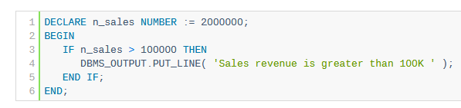
IF-THEN
The IF statement allows you to either execute or skip a sequence of statements, depending on a condition. The IF statement has the three forms:
IF THEN
IF THEN ELSE
IF THEN ELSIF
Example: the statements between THEN and END IF execute because the sales revenue is greater than 100,000.

Slide 6
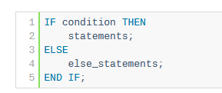
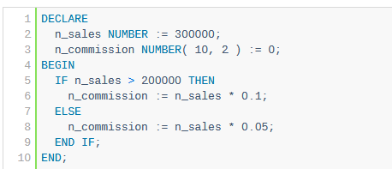
IF-THEN- ELSE
The IF THEN ELSE statement has the following structure:
Example sets the sales commission to 10% if the sales revenue is greater than 200,000. Otherwise, the sales commission is set to 5%.

Slide 7
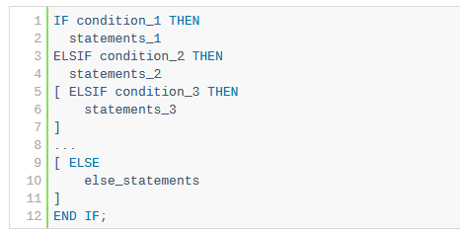
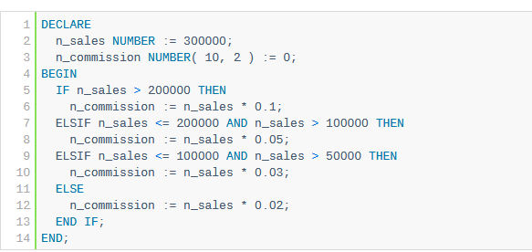
IF-THEN- ELSIF Statement
The following illustrates the structure of the IF THEN ELSIF statement:
Example uses the IF THEN ELSIF statement to set the sales commission based on the sales revenue.

Slide 8
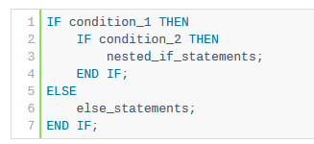
Nested IF Statement
You can nest an IF statement within another
IF statement as shown below:

Slide 9
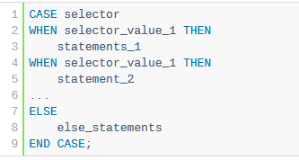
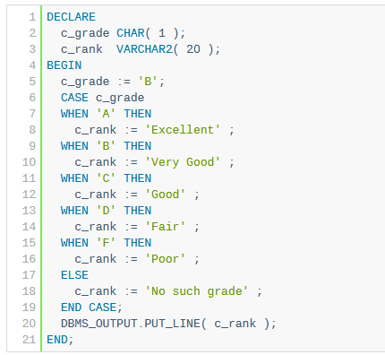
CASE Statement
The CASE statement chooses one sequence of statements to execute out of many possible sequences.
CASE statement example
Example compares single value (c_grade) with many possible values ‘A’, ‘B’,’C’,’D’, and ‘F’:

Slide 10
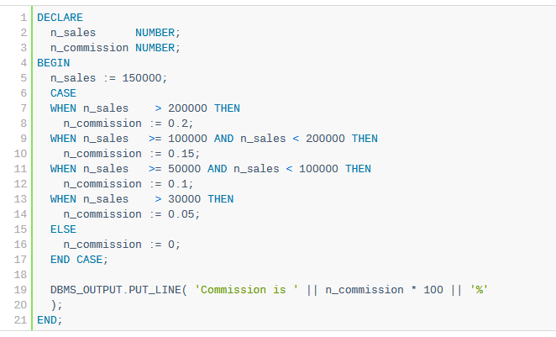

SEARCHED CASE Statement
Sales revenue was set to 150,000.
The first expression evaluated to FALSE:
But the second expression evaluates to TRUE and the sale commission was set to 15%:

Slide 11
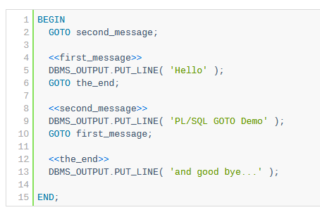
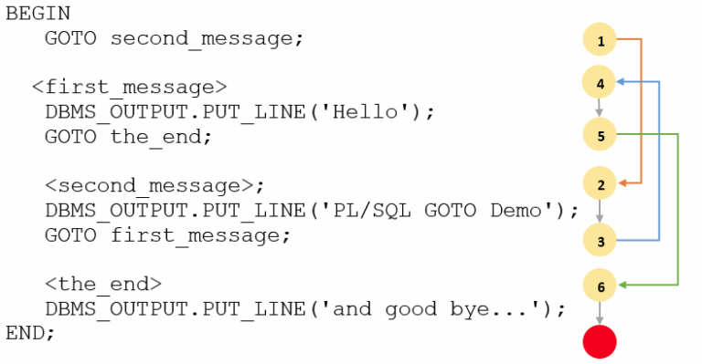

GOTO Statement
The GOTO statement allows you to transfer control to a labeled block or statement. The following illustrates the syntax of the GOTO statement:
The output is:

Slide 12
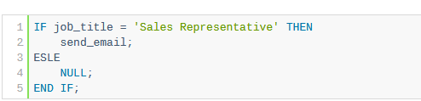
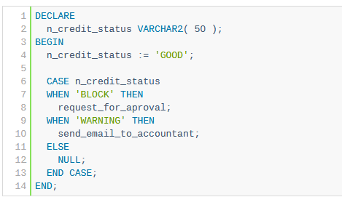
NULL Statement
The NULL statement is a NULL keyword followed by a semicolon (;). The NULL statement does nothing except that it passes control to the next statement.
Use a NULL statement in the ELSE clause of a simple CASE statement as shown in the following example:

Slide 13

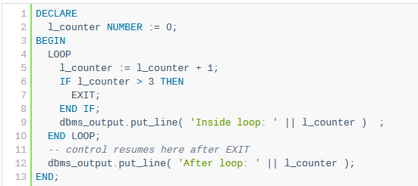

LOOPS
The PL/SQL LOOP statement has the following structure:
Example:
Use the LOOP statement to execute a sequence of code and EXIT statement to terminate the loop.
Here is the output:

Slide 14
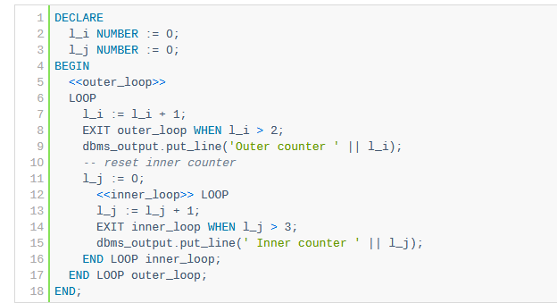
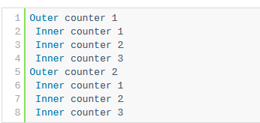
Nested LOOPS
Loop Inside Loop

Slide 15
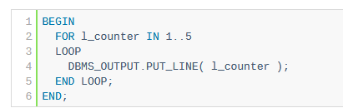
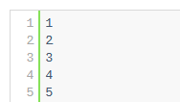
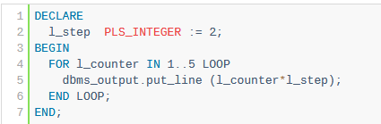
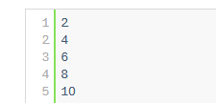
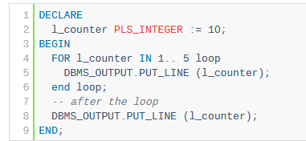
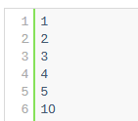
FOR Loop
A) Simple PL/SQL FOR LOOP example
B) Simulating STEP clause in FOR LOOP statement
C) Referencing variable with the same name as the loop index
What Happened??

Slide 16
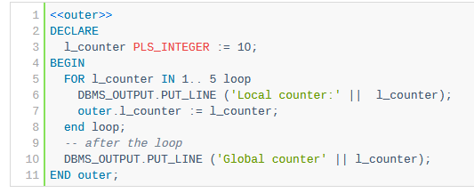
FOR Loop
To reference the variable l_counter inside the loop, you must qualify it using a block label

Slide 17

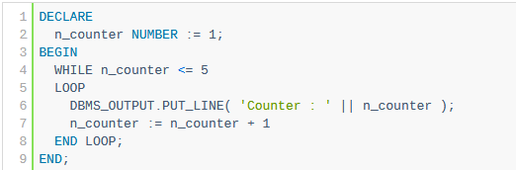
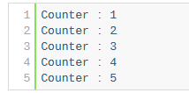
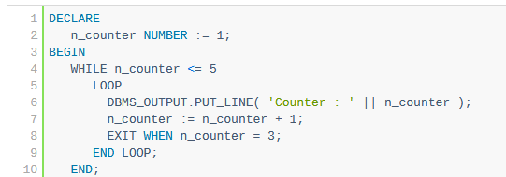

WHILE Loop
The WHILE loop statement continues to execute the statements between the LOOP and END LOOP as long as the condition in the WHILE clause evaluates to TRUE.
A) Simple WHILE loop example
B) WHILE loop example terminated by EXIT WHEN statement

Slide 18

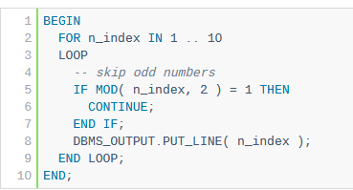
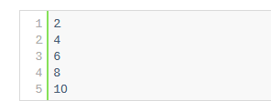
CONTINUE Statement
The CONTINUE statement allows you to exit the current loop iteration and immediately continue on to the next iteration of that loop.

